Slide 1

Yorkshire & Humber Care Record
Academy – Wave 2

Slide 2

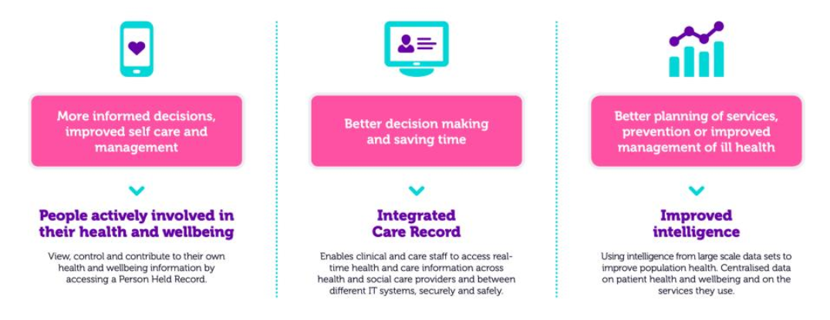
YHCR – a Future Proof Solution
The Yorkshire & Humber Care Record is reaching a level of maturity which supports its vision:
It now wants to secure optimum value from the technology by ensuring knowledge is shared across the region
The Academy’s vision is to create a regional knowledge base which enables the regions health and care system to gain maximum benefit from the YHCR framework and technology

Slide 3

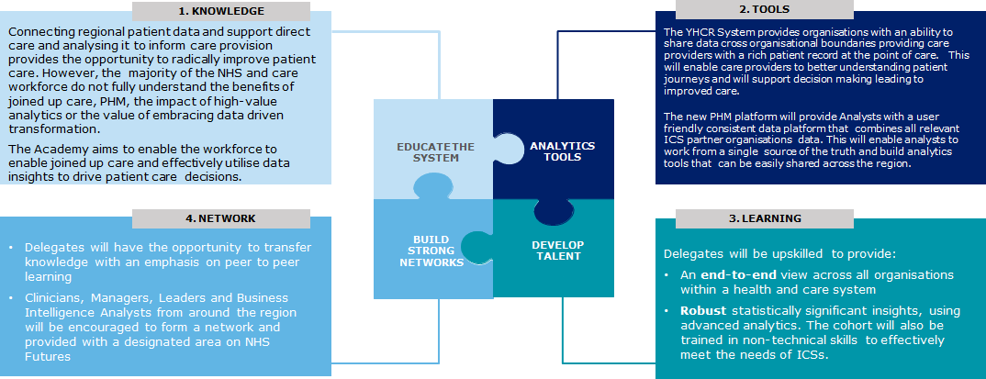
Supporting the transition to data driven care
The NHS Long Term Plan sets out a new strategic direction for data and analytics:
By 2021 all of England will operate in the Integrated Care Systems (ICSs) model
Population Health Management (PHM) – driving improvements in health across the population using a data driven approach
Local Health and Care Record Exemplars (LHCREs) – sharing and linking patient data across regional footprints to support ICS and PHM delivery
To realise the ambitious goals of the NHS, Yorkshire and Humber are delivering a regional integrated care record and a new Population Health Management platform supported by a Yorkshire & Humber Academy. These initiatives will build capability across four key domains:
2

Slide 4
Scope of Academy
The focus of the Academy will be on delivering training on integrated care to enable participants to adopt the YHCR for direct care purposes and use the PHM solution to deliver high-value analytics and shape care provision in the region
Academy Scope
Stakeholder Engagement
The LHCRE programme will provide regular progress updates and demos for interested stakeholder groups throughout the programme.
This engagement will be delivered according to the stakeholder engagement and communications plan set out by the programme.
These regular communications sit outside of the remit of the Academy and will therefore be managed separately.
The Academy launch event, which will include a platform showcase and progress update, will be open to all stakeholder groups.
Integrated Care Capability
The Academy will equip Leaders, Clinicians and Managers with the skills to:
Analytics and development capability
The Academy will provide the opportunity for developers and BI Analysts to:
1
Understand how to deliver direct care and PHM effectively
1
Enhance their development and analytics capabilities
2
Work collaboratively with BI functions to deliver data driven transformation
2
Build their knowledge and understanding of the YHCR platform
Equip them with core
non-technical skills to
succeed
Be effective leaders and
manage their
stakeholders
3
3
Academy Alumni will form an innovation network to share best practice and enhance cross role/organisation collaboration.
Academy Alumni will be able to access future learning and support through NHS Futures and will form part of a strong collaboration network.
3

Slide 5
Academy Learning Components
The design of the Academy puts participants at the centre, focusing on their needs and abilities and how best
to set them up for success.
Six Major Components of the Learning Program
Audience
Identifies the communities that will require learning, where they are located and what characteristics will drive the type of learning they receive.
Content
Identifies the topics to be included and the format the content will be created in.
Delivery Approach
Outlines the details around the modalities of the learning and who will receive which mode.
Tools
Documents what systems will be used to help create and deliver the learning.
Logistics
Outlines the activities that will need to be performed to support the learning execution: trainer identification, learning schedule, class registration, and the timing of these activities.
Support
Details the support mechanisms that will need to be in place for students.
1. Audience Organisations Roles Baseline
Knowledge
Geography
6. Support
FAQs
Drop in clinics
Email contact
5. Logistics
Venue Instructors Computers System access Data
2. Content Platform Documentation Knowledge Share
4. Tools
Instructor led Expert led Test data set Self directed
3. Delivery Approach
Workshops
Face to face teaching
Evaluation panels Project
4
5

Slide 6







Wave 2 - High-level Academy Delivery Plan
The Academy will evolve from its initial development to include direct care as well as PHM continuing to use the ADDDE method of instructional design. This method involves identifying what learners currently know, what they need to know, and creates interventions to bridge the gap.
1
Analyse 2 Design 3 Develop 4 Deliver 5 Evaluate
Sept- Oct 2020 | Sep - Oct 2020 | Sep 2020 - Mar 2021 | Nov 2020 - Mar 2021 | Mar - Apr 2021
Enhance W1 Academy objectives
Identify learning audiences and conduct learning needs assessment
Determine critical factors for successful learning delivery
Review existing resources and additional resource needs
Identify Academy lead
Identify cohort consultation group to test curriculum ahead of launch
Hold Academy design workshop and programme team consultations
Create high-level Academy curriculum and structure
Consult Analytics bodies and key stakeholders to refine
Publicise Academy and register participants
Revise W1 course curriculum
Finalise curriculum, training schedule and materials
Create test accounts and training environments
Launch course and publicity initiative
Create platform showcase materials
Establish course logistics incl. venues, speakers, materials, attendees etc.
Finalise learning delivery preparation, including facilities and learning delivery environment
Finalise learning materials prior to each module launch
Deliver learning
curriculum
Ensure online course access for participants and monitor usage
Set up virtual support clinics for participants
Evaluate learning courses in real-time
Develop end user learning maintenance plan based on course feedback
Review participant feedback
Create lessons learned for future Academy cycles
5
6

Slide 7
Academy Curriculum
Each cohort will have a bespoke curriculum tailored to their roles. This approach aims to build system wide knowledge of the YHCR platforms and better collaboration practices to deliver effective Integrated Care
 |  | Module 1 Defining and scoping the challenge | Module 2 Innovating together | Module 3 Interpreting data and delivery | Module 4 Integrated Care in Practice | Module 5 Final Showcase
PHM ANALYTICS / TECHNICAL TRAINING |  | Introduction to PHM Scoping the problem Introduction to Systems of Systems Building PHM Products Big Query Basics | Connected Bradford PHM In Context Producing mock ups | Interpreting data Python and Machine Learning Advanced Power BI | Information Governance Place Based Cancer PHM
CARE RECORD TECHNICAL TRAINING |  | Overview of Regional Aggregator Introduction to FHIR Deployment Deep Dive | National Services Cyber Security Cloud Computing with GCP | On-boarding Testing Clinical Safety | Maturity Model Information Governance Regional Use cases
MANAGEMENT, LEADERSHIP AND INFLUENCE |  | Change Management Business Case Development Tech for non-techies Safe and Secure Care | Regional Integrated Care Working with Partners | Personas and PHM Agile Delivering PHM Working with datasets | Collaboration and Influencing Transformation Enduring Models
MULTI-DISCIPLINARY SIMULATION PROJECT |  | Introduction to the Simulation Project | Simulation Proposals | Simulation review group | Simulation group work | Group Presentations to expert Panel
SKILLS
DELIVERY
Product Showcase & Networking
Classroom Learning
Virtual Coaching & Support
Alumnae Community
6

Slide 8
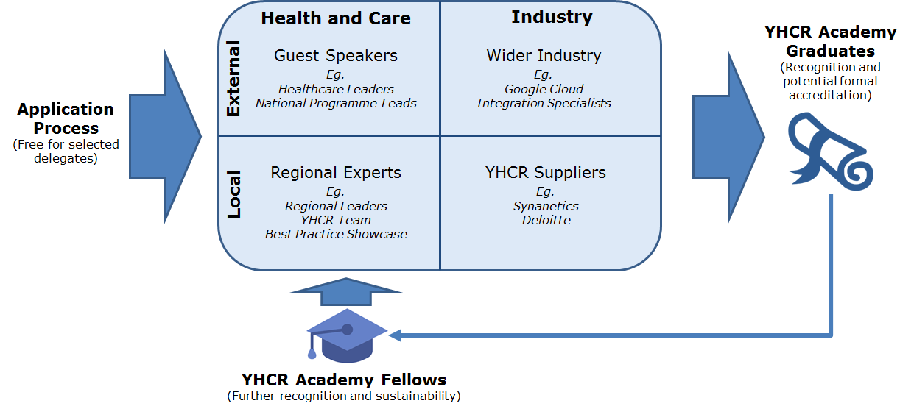
Academy Operating Model
The YHCR Academy operates based on a blend of Local / External and Health & Care / Industry experts
We will seek sponsorship from industry wherever possible to help cover costs
The approach provides recognition for graduates and CPD points (subject to confirmation of curriculum)
Further recognition plus increasing local self-sustainability is possible based on a Fellowship scheme

Slide 9
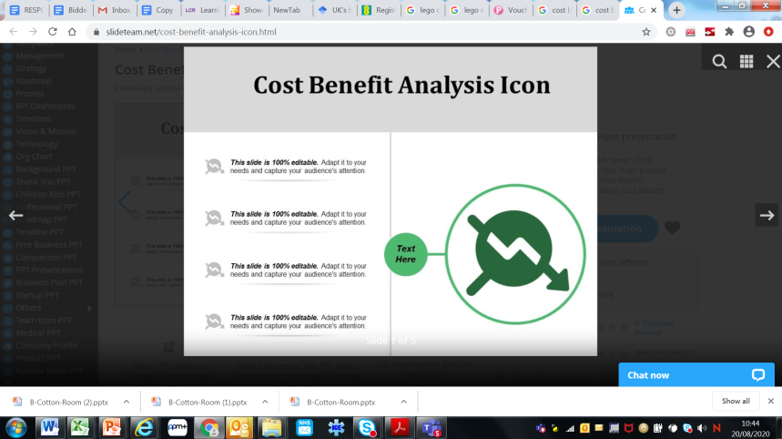

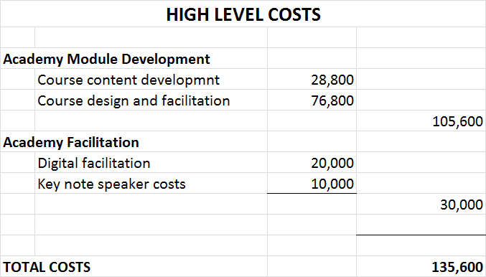
Benefits v’s Costs
The regional investment now in the YHCR academy will reap benefits going forward which over time outweighs the initial investment costs. Key benefit areas are noted below.
Reduced contract market costs - attract talented people to work within the region and support the creation of a highly diverse, skilled and engaged workforce to support integrated care – saving = lower contract resource costs
Improved care- accelerate our ambition to improve access to peoples health and care information across the region though increased understanding of the challenges leading to process improvement cost reduction
Economies of scale- reduced siloed project delivery through a greater understanding of a common but flexible integration approach across the region
Reduced supplier costs – investment in digital skills will enable a lower reliance on supplier services into the medium and longer term allowing the regional to become more self sufficient

